Slide 1
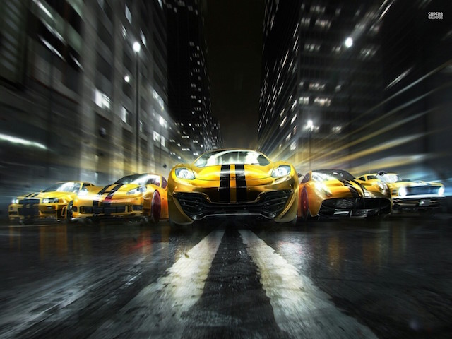

Burning Tire…
Presented By
Anant
Aakash
Albert

Slide 2
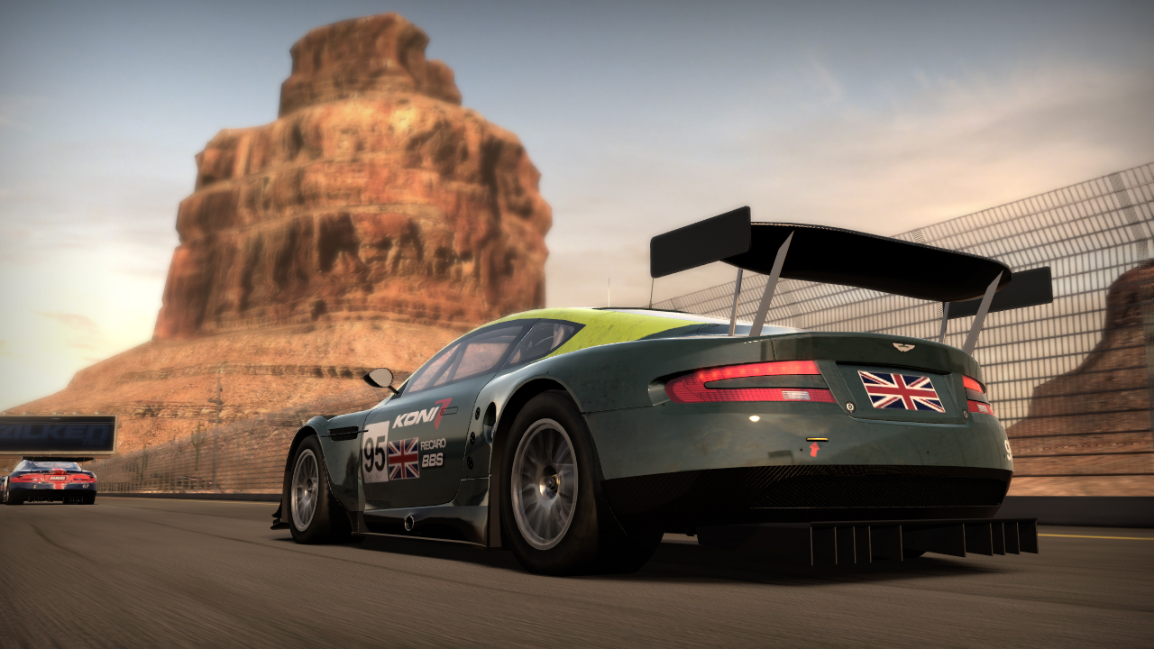
Ready to Thrill..
How to ride...
How to strike high score…
Game Mechanics…

Slide 3






Theme - Desert

Slide 4
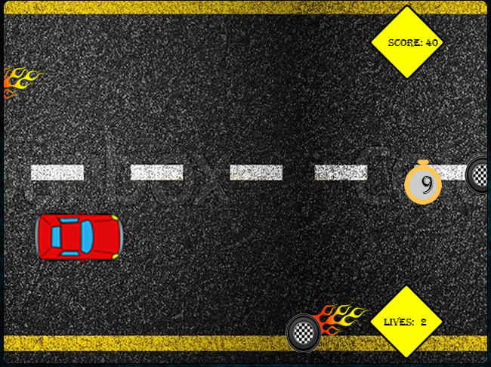

Theme- Burning wheel

Slide 5
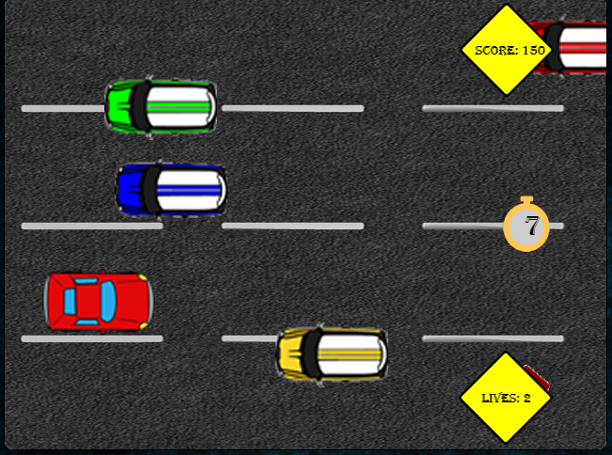

Theme- Street Racing

Slide 6
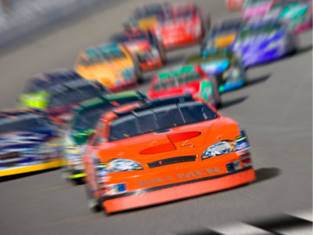

Time to Race

